Slide 1

Information Security Engr. Syed Rizwan

Slide 2
What is security?
In general, security is:
“the quality or state of being secure—to be free from danger.”
In other words, protection against adversaries—from those who would do harm, intentionally or otherwise—is the objective.

Slide 3
Multiple layers of security
Physical security,
to protect physical items, objects, or areas from unauthorized access and misuse
Personnel security,
to protect the individual or group of individuals who are authorized to access the organization and its operations
Operations security,
to protect the details of a particular operation or series of activities

Slide 4
Multiple layers of security
Communications security,
to protect communications media, technology, and content
Network security,
to protect networking components, connections, and contents
Information security,
to protect the confidentiality, integrity and availability of information assets, whether in storage, processing, or transmission.
It is achieved via the application of policy, education, training and awareness, and technology.

Slide 5
Key information security concepts
Access
Asset
Attack
Control
Exploit
Exposure
Lost
Protection profile
Risk
Subjects and Objects
Threat
Threat agent
Vulnerability
Backdoors
Direct Access Attack
Tampering
Denial of Service Attack
Spoofing
Eavesdroping
Information Disclosure
Indirect Attack

Slide 6
Key information security concepts
Access
A subject or object’s ability to use, manipulate, modify, or affect another subject or object.
Authorized users have legal access to a system, whereas hackers have illegal access to a system.
Access controls regulate this ability.
Asset
The organizational resource that is being protected.
An asset can be logical, such as a Web site, information, or data; or an asset can be physical, such as a person, computer system, or other tangible object.
Assets, and particularly information assets, are the focus of security efforts; they are what those efforts are attempting to protect.

Slide 7
Key information security concepts
Attack
An intentional or unintentional act that can cause damage to or otherwise compromise information and/or the systems that support it.
Attacks can be active or passive, intentional or unintentional, and direct or indirect.
Control
or Safeguard or countermeasure
Security mechanisms, policies, or procedures that can successfully counter attacks, reduce risk, resolve vulnerabilities, and otherwise improve the security within an organization.

Slide 8
Key information security concepts
Exploit
A technique used to compromise a system. This term can be a verb or a noun. Threat agents may attempt to exploit a system or other information asset by using it illegally for their personal gain.
Or, an exploit can be a documented process to take advantage of a vulnerability or exposure, usually in software, that is either inherent in the software or is created by the attacker.
Exploits make use of existing software tools or custom-made software components.
Exposure
A condition or state of being exposed. In information security, exposure exists when a vulnerability known to an attacker is present.

Slide 9
Key information security concepts
Lost
A single instance of an information asset suffering damage or unintended or unauthorized modification or disclosure.
When an organization’s information is stolen, it has suffered a loss.
Protection profile
or security posture or security program
The entire set of controls and safeguards, including policy, education, training and awareness, and technology, that the organization implements (or fails to implement) to protect the asset.

Slide 10
Key information security concepts
Risk
The probability that something unwanted will happen. Organizations must minimize risk to match their risk appetite—the quantity and nature of risk the organization is willing to accept.
Subjects and Objects
A computer can be either the subject of an attack—an agent entity used to conduct the attack—or the object of an attack—the target entity.
A computer can be both the subject and object of an attack, when, for example, it is compromised by an attack (object), and is then used to attack other systems (subject).

Slide 11
Key information security concepts
Threat
A category of objects, persons, or other entities that presents a danger to an asset.
Threats are always present and can be purposeful or undirected.
For example, hackers purposefully threaten unprotected information systems, while severe storms incidentally threaten buildings and their contents.
Threat agent
The specific instance or a component of a threat.
For example, all hackers in the world present a collective threat, while Kevin Mitnick, who was convicted for hacking into phone systems, is a specific threat agent.

Slide 12
Key information security concepts
Vulnerability:
Vulnerability is a weakness which allows an attacker to reduce a system's information assurance. Vulnerability is the intersection of three elements: a system flaw, attacker access to the flaw, and attacker capability to exploit the flaw. To exploit vulnerability, an attacker must have at least one applicable tool or technique that can connect to a system weakness. In this frame, vulnerability is also known as the attack surface.
Backdoors
A backdoor in a computer system, is a method of bypassing normal authentication, securing remote access to a computer, obtaining access to plaintext, and so on, while attempting to remain undetected. The backdoor may take the form of an installed program (e.g., Back Orifice), or could be a modification to an existing program or hardware device.

Slide 13
Key information security concepts
Direct-access attacks
An unauthorized user gaining physical access to a computer (or part thereof) can perform many functions, install different types of devices to compromise security, including operating system modifications, software worms, key loggers, and covert listening devices. The attacker can also easily download large quantities of data onto backup media, for instance CD-R/DVD-R, tape; or portable devices such as key drives, digital cameras or digital audio players. Another common technique is to boot an operating system contained on a CD-ROM or other bootable media and read the data from the hard drive(s) this way.
Tampering:
Tampering describes an modification of products in a way that would make them harmful to the consumer.

Slide 14
Key information security concepts
Denial-of-service attack
Denials of service attacks are not used to gain unauthorized access or control of a system. They are instead designed to render it unusable. Attackers can deny service to individual victims. These types of attack are, in practice, very hard to prevent, because the behavior of whole networks needs to be analyzed, not only the behavior of small pieces of code.
Spoofing
Spoofing of user identity describes a situation in which one person or program successfully pretenses as another by falsifying data and thereby gaining an illegitimate advantage.

Slide 15
Key information security concepts
Eavesdropping
Eavesdropping is the act of surreptitiously listening to a private conversation, typically between hosts on a network. For instance, programs such as Carnivore and Narusinsight have been used by the FBI and NSA to eavesdrop on the systems of internet service providers.
Information Disclosure
Information Disclosure (Privacy breach or Data leak) describes a situation where information, thought as secure, is released in an untrusted environment.
Indirect attack
An indirect attack is an attack launched by a third-party computer. By using someone else's computer to launch an attack, it becomes far more difficult to track down the actual attacker.

Slide 16
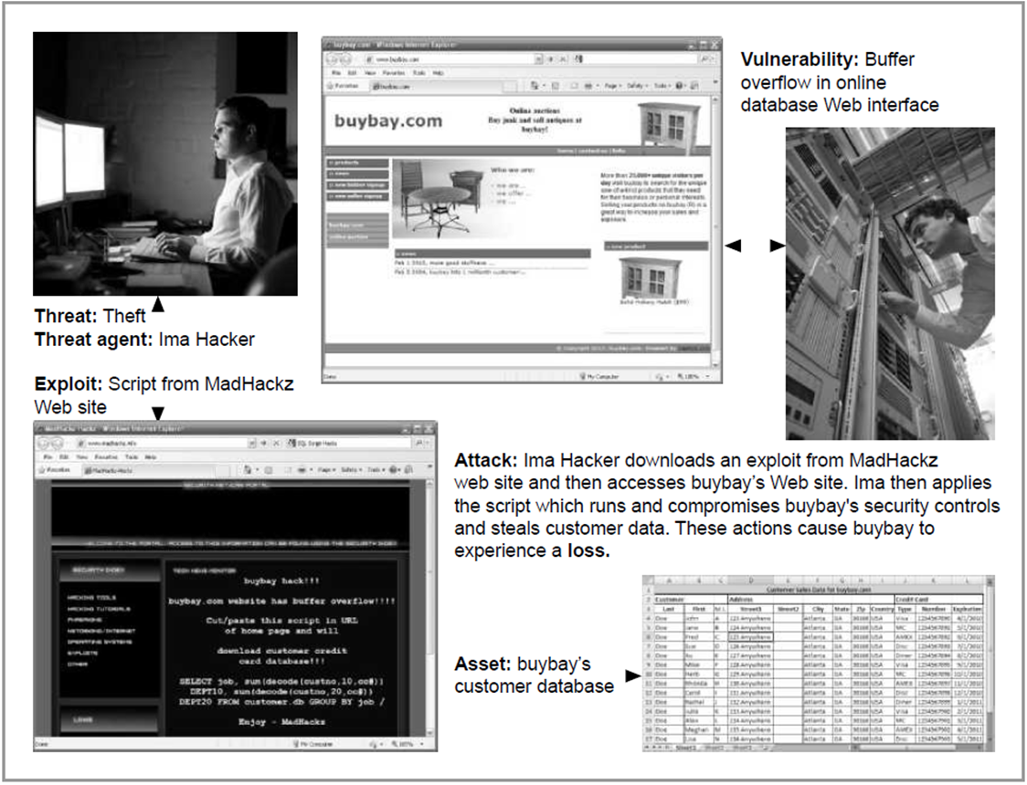
Example

Slide 17
Questions ?

